Slide 1
Major project review
HARSH TIWARI (RA1611008010201)
KUSH DEEPAK SHARMA (RA1611008010301)
SANAL SINGH TOMAR (RA16110080509)

Slide 2
Narcotic identification and interaction checker based on IoT and Machine learning to minimise the fatalities

Slide 3
INTRODUCTION
The project takes into consideration of the real life problem of “Excessive drinking and use of narcotics substance in Public places” and provides a technological and monetarily feasible solution to the statement.
In the implementation of this project we are mainly focused on the safety of the People at public places like Mall, Subways etc.

Slide 4
Problem statement
Everyday an average of 19 citizens in India die due to DUI.
Drink-driving accidents accounted for only 1.5% of all accidents, according to NCRB data, they were the deadliest, having a higher fatality rate than other causes, according to this analysis.
As many as 42% of victims of drink-driving accidents died, compared to accidents caused by over-speeding (30%), reckless driving (33%), and weather conditions (36%).
So, although the percentage of Drink-driving accident is less but the death ratio is maximum hence it is the most fatal type of accident.

Slide 5
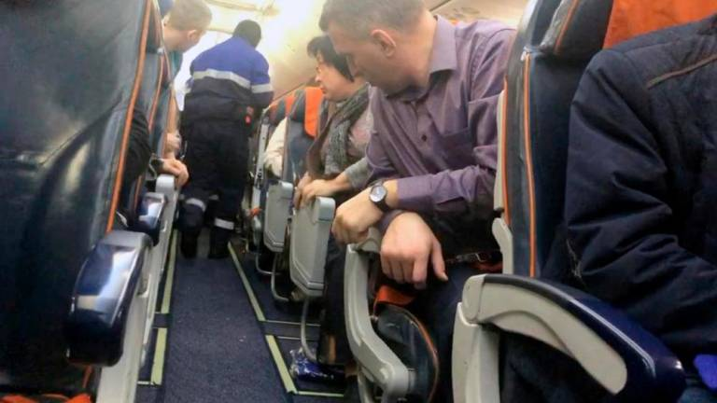
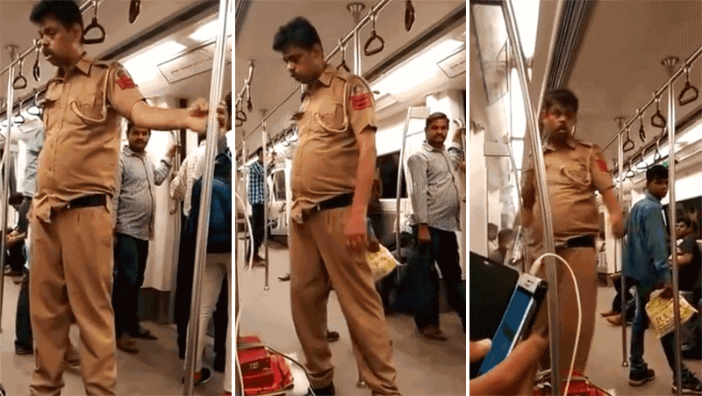
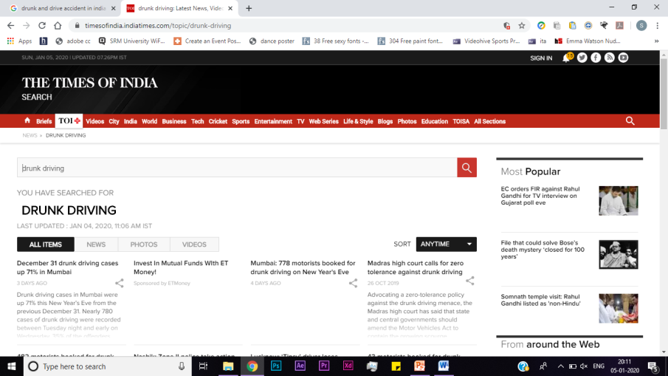
Seldom we find people at public places who are under influence of alcohol creating embarrassing scenes.
A viral video of a police man who is under the influence of alcohol creating a scene in a metro train in DELHI.
390 stories of accidents due to Drunk and drive published in TOI in the month of DEC, 2020.

Slide 6
Who is most at risk?
Young people:
At all levels of blood alcohol concentration (BAC), the risk of being involved in a crash is greater for young people than for older people.
Among drivers with BAC levels of 0.08% or higher involved in fatal crashes in 2016, nearly three in 10 were between 25 and 34 years of age (27%). The next two largest groups were ages 21 to 24 (26%) and 35 to 44 (22%).
Bad Influence of alcohol and Passive smoking specially on children's
Passive Smoking:
Passive smoking increases the risk of coronary heart disease by 25-40% - almost the same level as a smoker
Motorcyclists:
Among motorcyclists killed in fatal crashes in 2016, 25% had BACs of 0.08% or greater.
Motorcyclists ages 35-39 have the highest percentage of deaths with BACs of 0.08% or greater (38% in 2016).
Drivers with prior driving while impaired (DWI) convictions:
Drivers with a BAC of 0.08% or higher involved in fatal crashes were 4.5 times more likely to have a prior conviction for DWI than were drivers with no alcohol in their system. (9% and 2%, respectively).

Slide 7
Literature survey
Existing System
Drawbacks in the system
Proposed System

Slide 8
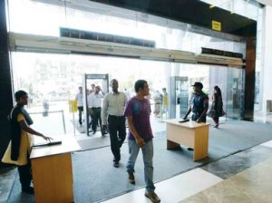
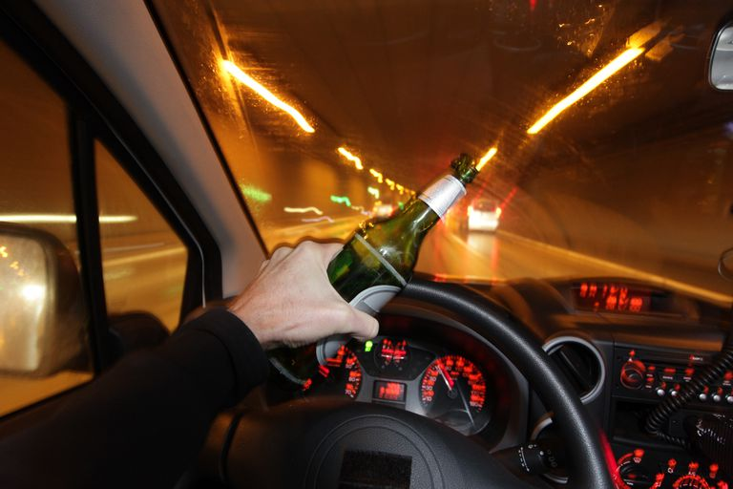
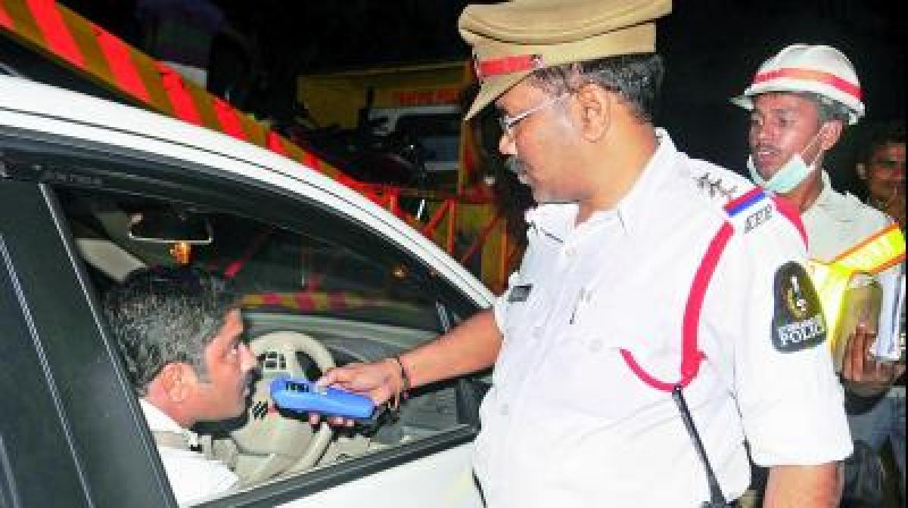
Existing system
In this slide we will focus on Security Systems that already exist but could be made more effective if Narcotic identification and interaction checker are used.

Slide 9
Existing system
As per the previous researches which have been done on the alcohol detection some of the authors proposed their ideas among them.
Z. Xiaoronget proposed a model for automatic alcohol detection based on using alcohol sensor MQ-3 and IOT, he used STC12C516A microcontroller and alcohol sensor as maincomponents, by using these he detect the alcohol contentment in the breath same as the breath analyzer, author fits alcohol sensor, LCD display, GPRS module in the vehicle, if thealcohol content detect over the limit then automatically buzzering sound, LCD display will show the range of the alcohol content in the breath at the same time it sends the information to nearby cops with exact location of the vehicle the vehicle automatically off.

Slide 10
The second was reviewed and proposed by J. Dai, implemented by using android phone which is equipped with the accelerometer and an orientation sensor to known whether driver is drunk or not. An android app is installed in the system with stores the data about the vehicle acceleration speed and sudden braking system. if vehicle cross the speed limit. Sudden braking then app gets activated start alarm.
Third method is about the physiological behaviour of the drunken person as well as the physical changes, which can be detected by using the special sensors. The main changes in the body is sudden increase in the heart beat.

Slide 11
Drawbacks of the system
Whole system depends on the mq-3 sensor only, if the sensor got damage no use.
Threshold value of the system is static.
A single algorithm is used for the entire system for all test conditions.
This method is depending on the Smartphone only, if phone does not work properly this method will fail.
Long time using of these sensors, may works inefficiently.
Wearing these sensors may cause distraction while driving.

Slide 12
Proposed system
Different methods were proposed to the existing major problem drunken driving detection, but we didn’t get proper measurements by this. Therefore, we propose a novel method to combine a number of factors and personalize for testing people, other than normal approach.
The various parameters considered for the proposed project are:
• Blood pressure and pulse rating
• Alcohol content
• Smoke content
• Facial expressions

Slide 13
When the driver touches the start/stop button, the detection system will be powered and activated. Now-a-days our cars are getting smarter and a new safety feature is being developed to protect against drunk driving. The touch based technology reads blood alcohol below the skin surface. Touch sensors will be placed in the car ignition button or in the gearshift shine. A beam of light on to a finger, this touch based system uses infrared ray’s spectroscopy to detect the level of alcohol in the blood. Alcohol absorbs specific wavelengths of light by measuring the lights intensity the system can precisely pinpoint driver’s blood alcohol level. If the blood alcohol concentration rises above the legal limit, the system counts as ‘1’, if not ‘0’. Simultaneously the system moves to other sensors i.e. breath based system (using MQ-3 alcohol sensor), Heart beat sensor, Facial recognition system. When these sensors above the alcoholic legal limit, it counts as ‘1’, if not ‘0’ for all the sensors. If the system matches three of the sensors automatically the ignition will be off.

Slide 14
Usefulness of the project
Safe driving: There are many accidents in which the driver often loses his precious life under the influence of alcohol.
Prevents traffic chaos: A person under the influence of alcohol doesn’t have control over his actions as it impacts synchronised coordination of brain and body, as a result, he/she violates the traffic rules which can prove to be fatal. The proposed system takes action based on the alcohol content.
Compact size: Only the MQ-3 alcohol sensor has to be placed on the steering wheel and the rest of the components are hidden. The MQ3 sensor doesn’t occupy more than 3 inches space.

Slide 15
Reduced number of accidents: The main focus of this system is to reduce the number of accidents due to alcohol consumption during driving. The embedded GPS alerts the registered mobile number so that action can get initiated and the victim get immediate medical attention (often the reason cited for fatality is delayed medical care).
Apt complementing device for cops: Every vehicle cannot be checked by the cops manually. This device can automate the process (alerts can be made to reach the local police station), thus freeing the cops to task more important tasks such as investigation of robbery, murder and other crimes in the society.
Safety of innocent public: We could avoid embarrassing or harmful incidents by taking sutaible precautions.

Slide 16
Proposed system Architecture

Slide 17
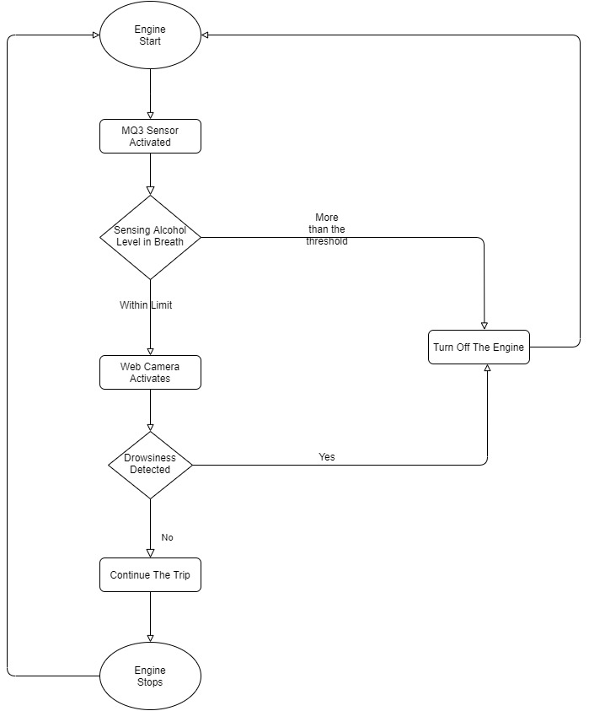

Slide 18
Drowsiness detection module

Slide 19
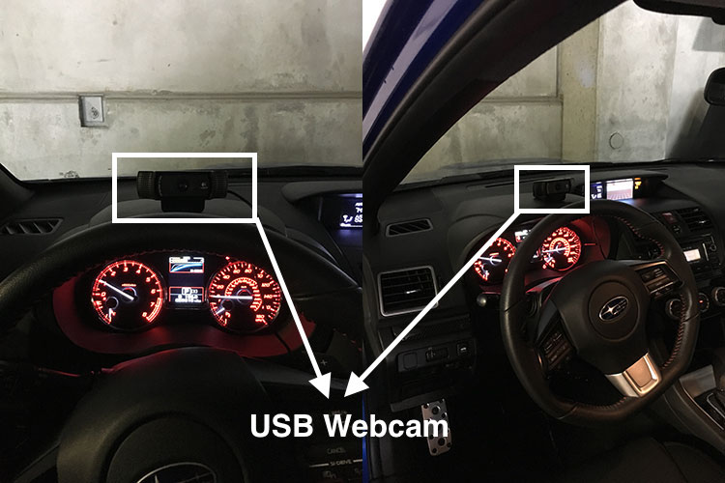
Step 1:
First, the camera has to be setup that monitors a stream for faces.

Slide 20
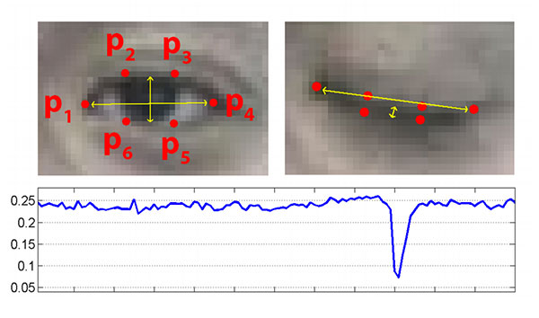
Step 2:
If a face is found, the facial landmark detection is applied and the eye regions are being extracted.

Slide 21
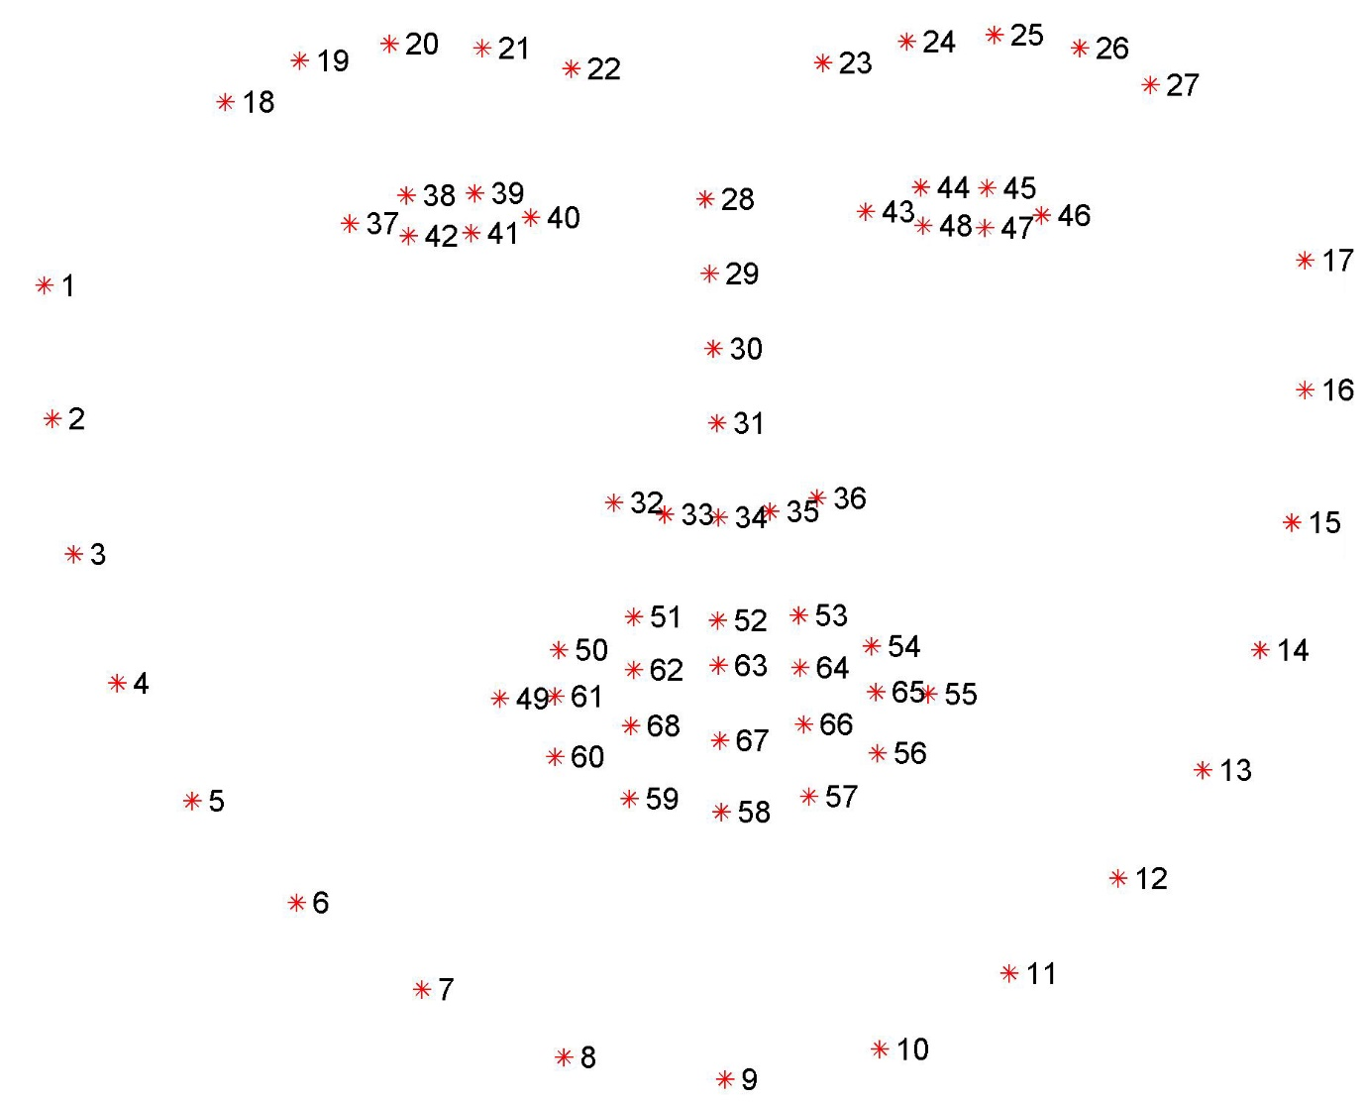
to extract the eye regions from a set of facial landmarks, it is simply needed to know the correct array slice indexes.

Slide 22
Step 3:
Now that the eye regions have been obtained, the eye aspect ratio (EAR) can be computed easily to determine if the eyes are closed.
Step 4:
If the eye aspect ratio indicates that the eyes have been closed for a sufficiently long enough amount of time, the sound of an alarm is raised to wake up the driver.

Slide 23
EYE_AR_THRESH is defined as constant variable. If the eye aspect ratio falls below this threshold, it will start counting the number of frames the person has closed their eyes for.
If the number of frames the person has closed their eyes in exceeds EYE_AR_CONSEC_FRAMES, it will sound an alarm.
EYE_AR_THRESH of 0.3 works well in a variety of situations (although it is needed to train the application according to the situations).
The EYE_AR_CONSEC_FRAMES has been set to 48, meaning that if a person has closed their eyes for 48 consecutive frames, we’ll play the alarm sound. So that alarm sound on blinking of eyes could be prevented.
The drowsiness detector could be made more sensitive by reducing the value of EYE_AR_CONSEC_FRAMES — similarly, it could be made less sensitive by increasing it.

Slide 24
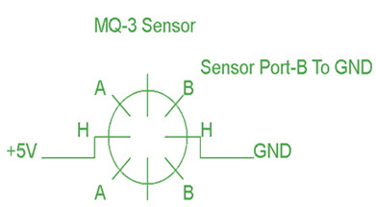
WORKING PRINCIPLE OF SENSORS
The MQ-3 alcohol gas sensor consists of total 6-pins including A, H, B and the other three pins are A, H, B out of the total 6-pins we use only 4 pins. The two pins A, H are used for the heating purpose and the other two pins are used for the ground and power

Slide 25
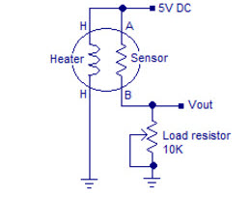

Slide 26
The heartbeat sensor is based on the principle of photo phlethysmography. It measures the change in volume of blood through any organ of the body which causes a change in the light intensity through that organ

Slide 27
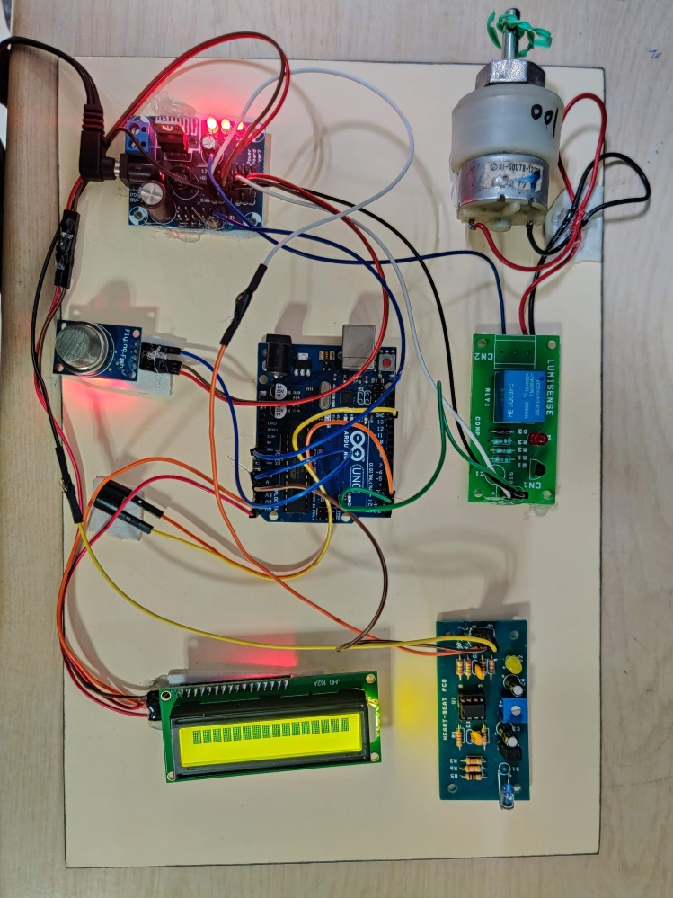
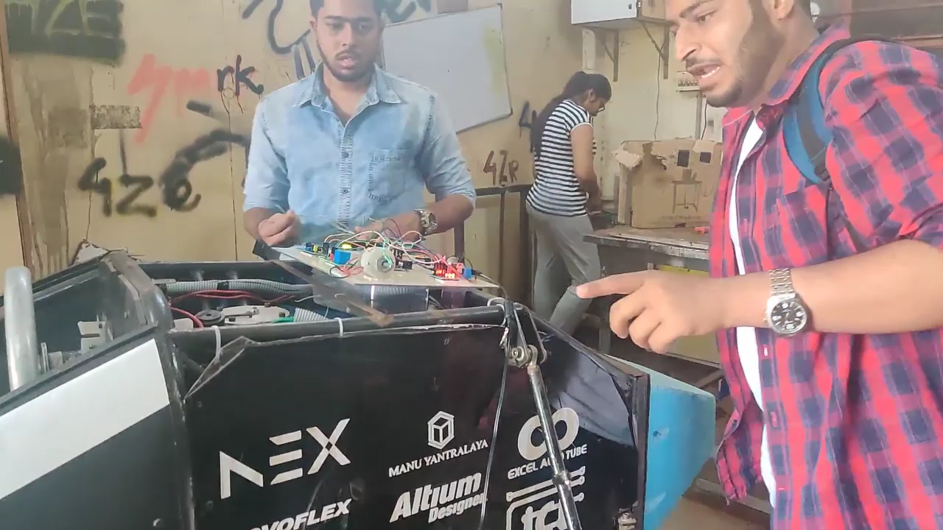
The prototype Model has been tested and for the purpose of demonstration, the car motor has been replaced with a compact motor.

Slide 28
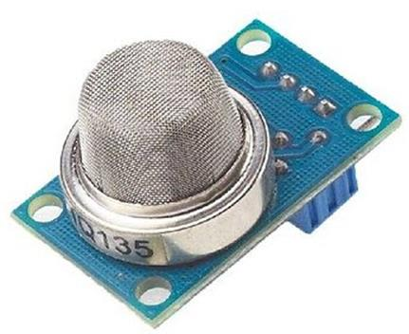

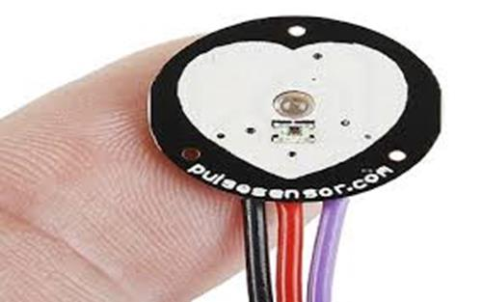
ATTACHMENTS
MQ3 Sensor
Web Cam
Pulse sensor

Slide 29
CODE

Slide 30
Thank you !!!

